Slide 1

SPONSORSHIP OPPORTUNITIES · OCTOBER 2026
Love Music More
A weekly music-craft show, newsletter, video channel, and archive for musicians, producers, engineers, and deep listeners.
Host-read sponsorships, custom Substack posts, YouTube and podcast placements, and evergreen archive links.
Tuesdays
226+
4,000+
new episode every week
episodes published
email subscribers

Slide 2





Where a sponsor shows up
Love Music More sits inside the Scoobert Doobert creator ecosystem. One weekly episode feeds five surfaces, and a sponsor can be present on all of them.
Podcast audio feed
Spotify, Apple Podcasts, and RSS
YouTube podcast
Full episodes, clips, and descriptions with sponsor links
New episode every Tuesday
Substack newsletter
226+ episodes · 85 interview guests
Posts live in the inbox and in the web archive
Scoobert Doobert artist channel
Official artist channel, music videos, and shorts
Searchable archive
Episode notes keep links findable on lukefwalton.com
Sources: Love Music More site, podcast, and newsletter publishing model; YouTube Studio; Spotify for Creators.

Slide 3
Current reach sponsors can buy into
Owned audience, podcast reach, and the official artist channel the show lives on.
LOVE MUSIC MORE
SCOOBERT DOOBERT OFFICIAL ARTIST CHANNEL
4,000+
92% of Love Music More views come from the official artist channel.
Substack subscribers — owned audience, email reporting can include opens and clicks
18.8K
10.1K
channel views, last 28 days
unique viewers, last 28 days
5.1K
21K+
YouTube podcast views, last 28 days
all-time Spotify plays and downloads
412h
1.4K
148K+
226+
watch time, last 28 days
YouTube channel subscribers
lifetime YouTube podcast views
episodes published, every Tuesday
Sources: YouTube Studio channel and podcast analytics, Spotify for Creators, and Substack subscribe modal.

Slide 4
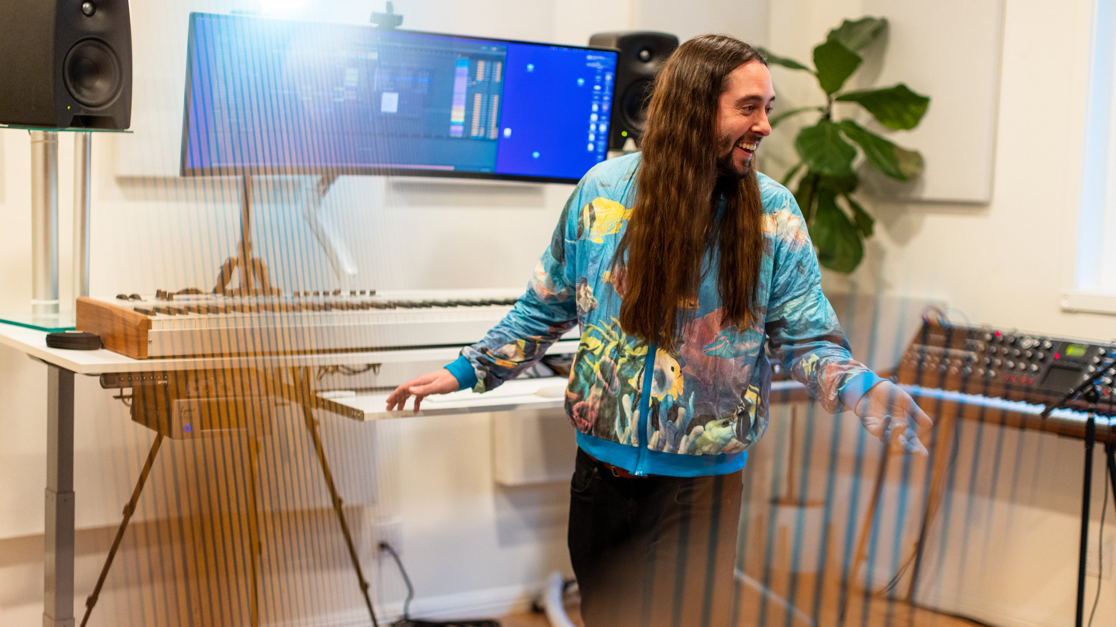




Scoobert Doobert is the context, not just the host
Sponsors are not buying generic podcast inventory. They are entering a creator world with music releases, production credits, videos, interviews, essays, and a direct audience.
Artist and producer
Records as Scoobert Doobert, with music videos and shorts that already move.
Host of a weekly music-craft show
226+ episodes and 85 interview guests.
Producer, mixer, and player
For Japanese TV, film, and artist projects: CHAI, bed (Fuji TV), OKAME.
A recognizable editorial voice
Serious craft, weird questions, and practical music ideas.
92% of Love Music More views come from the official Scoobert Doobert artist channel.
Love Music More · Sponsorship opportunities · October 2026
4

Slide 5



A music-native adult audience
The audience is concentrated where music tools, education products, creator services, and gear brands want to reach: adult musicians and serious music fans.
AUDIENCE FIT
YOUTUBE VIEWS BY AGE
Music-makers and producers
People who buy tools, plugins, courses, and services.
18–24
25–34
35–44
45+
82.7%
76%
Recurring lanes
Production craft, music history, practice, wellness, and creative work.
of YouTube views from age 25–44
of all-platform listening from the U.S.
Deep listeners
Global reach across 130+ countries and territories, led by the U.S.
Long-form conversations with working engineers, producers, and artists.
Sources: YouTube Studio audience analytics; Spotify/Apple/RSS geolocation exports; Love Music More archive.

Slide 6
Guests sponsors will recognize
85 interview guests so far: Grammy-winning mix engineers, hit songwriters, session players, and punk pioneers. A sample:
AS
CB
DB
PB
Andrew Scheps
Craig Bauer
David Baron
Phillip Broussard Jr.
Grammy-winning mix engineer
Grammy-winning engineer
Producer and mixer
Engineer and mixer
Adele, U2, Hozier
Janet Jackson, Lupe Fiasco, Destiny's Child
Noah Kahan, Lana Del Rey, Lenny Kravitz
Red Hot Chili Peppers, Rick Rubin, Adele, Eminem
JJ
HF
BS
AD
Jay Jay French
Harley Flanagan
Bermuda Schwartz
Alex Delicata
Founder and manager
Founder and punk pioneer
Drummer
Songwriter and producer
Twisted Sister
Cro-Mags, Stimulators
“Weird Al” Yankovic
Beyoncé, Rihanna, Machine Gun Kelly, OneRepublic
Full guest list: lukefwalton.com/love-music-more/guests

Slide 7


A campaign can keep working after publish week
Two connected engines: short-form discovery brings people in; long-form episodes, playlists, email, and archive pages carry the deeper attention.
PERSISTENT SPONSOR SURFACES
YOUTUBE ROLE SPLIT
Views share
Embedded reads stay in the episode.
Watch-time share
Substack posts live in the inbox and the web archive.
Shorts
1–10 min
Long-form
Episode notes keep links searchable.
Shorts win the views; long-form holds the hours. A sponsor can reach both: fast discovery and deeper attention.
YouTube clips and descriptions keep circulating.
Sources: YouTube Studio lifetime export by content length; Love Music More site, podcast, and newsletter publishing model.

Slide 8




Partnership opportunities
Choose the level that matches the campaign: a single-episode test, a monthly presence, or category ownership with custom content.
Episode Partner
Monthly Partner
Category Partner
from $500 / episode
from $1,000 / month
from $2,500 / month
1 embedded host read
4 embedded host reads
4–8 reads / placements
Episode notes + link
4 newsletter placements
Category exclusivity window
YouTube description link
Site/archive link placement
Custom Substack post or series
Good for launch tests
Monthly recap
Short-form clips or demo
Partnerships can be customized around launch timing, category fit, exclusivity, and reporting needs.
SPONSORS PAST AND PRESENT
Pricing shown as starting points; final scope depends on category, exclusivity, creative needs, and campaign length.

Slide 9

A practical 30-day pilot
The cleanest starting point is a focused month: enough repetition to be remembered, enough reporting to know what worked, and no complicated production lift.
1
WEEK 1
2
WEEKS 2–4
3
AFTER DAY 30
Launch
Repetition
Campaign recap
Launch read + newsletter placement
Sponsor link in episode notes
YouTube description link
Weekly host-read reminders
Optional short-form cutdowns
Custom Substack post if included
Reach, clicks, email metrics
Top-performing surfaces
Recommendation for renewal
Built for persistence. Reads are baked into episodes, links remain in show notes and archive pages, and sponsor content can continue to be found after the campaign window.
Pilot scope can be expanded with product education, giveaway mechanics, newsletter-only sends, or category exclusivity.

Slide 10

LET’S BUILD THE RIGHT CAMPAIGN
Reach music people in a format built on trust.
A sponsor can show up inside the audio, the video, the inbox, and the searchable archive — not just as a one-off post that disappears.
Embedded host reads
Custom Substack posts
YouTube + podcast links
Campaign reporting
SPONSORSHIP CONTACT
WEB
Sam Friend · beformer.co@gmail.com
lovemusicmore.substack.com
lukefwalton.com · scoobertdoobert.pizza
Sponsors past and present: DistroKid, Minuendo, Vinyl Moon

